Slide 1
Warm Up
Contrast Geocentric and Helicentric Models

Slide 2
Opening Chapter 1 Review Questions
(1.2) What causes the seasons? Seasons are Caused by the tilt of the Earths rotational axis(page 22)
2. (1.3) What causes the Moon’s phases? The moons motion or orbit around the Earth (pages 26-27)
3. (1.3) How long does it take the Moon to go through a cycle of phases? 29. 5 days

Slide 3
Opening Chapter 1 ReviewQuestions
4. (1.1) If you are standing at the Earth’s North Pole, which of the following will be directly overhead? Pg.18
(a)The celestial equator
(b)The ecliptic
(c)The zodiac
(d)The north celestial pole
(e)The Sun
5. (1.1) If you observe Polaris to be 30° above the horizon, you are at a latitude of approximately
(a) 6.5°
(b) 30°
(c) 53.5°
(d) 60°
(e) 83.5°

Slide 4
Opening Chapter 1 Review Questions
6. For this question, choose as many answers as are correct.
If the Earth reversed its direction of spin,
the Sun would rise in the west and set in the east.
(b )the seasons would be reversed.
(c ) the stars would circle Polaris clockwise.
(d ) the Moon would rise in the west and set in the east.
(e) the Moon would rise in the east and set in the west.
7. (1.2) In the Northern Hemisphere, summertime is warmer than wintertime because
(a)the Earth’s orbit is an ellipse.
(b)the Sun is visible for more hours.
(c)sunlight is more concentrated on the ground.
(d)both b and c.
(e)All the answers are true.

Slide 5
Opening Chapter 1 Review Questions
8. In which of the following locations can the length of ­daylight range from zero to 24 hours?
(a)Only on the equator
(b)At latitudes closer than 23.5° to the equator
(c)At latitudes between 23.5° and 66.5° north or south
(d)At latitudes greater than 66.5° north or south
(e)Nowhere on Earth
#8 will NOT be on test or quiz
9. (1.3) If the Moon is waning gibbous in Chicago, then that night in Australia the Moon will be
(a)waxing crescent.
(b)waning gibbous
(c)waxing gibbous.
(d)waning crescent.

Slide 6
Opening Chapter 1 Review Questions
10. (1.3) You observe the Moon rising at 6 p.m., around sunset. Its phase is (pg.28)
(a) 1st quarter
(b) new
(c) full
(d )3rd quarter
11. (1.3) You observe the Moon rising at 3 p.m., a few hours before sunset. Its phase is (page 28)
(a) between new and first quarter.
(b )between first quarter and full.
(c) between full and third quarter.
(d) between third quarter and new.
12. (1.3) If you see a full moon at midnight,
about how long will it be until there is a new moon?
(a) 12 hours
(b )3 days
(c) 2 weeks
(d )6 months

Slide 7
Study for Vocabulary Quiz tomorrow
Star
Satellite
Solar system
Milky way
Universe
Planet
Galaxy
Celestial Equator
Celestial pole
Celestial Sphere
Precession
Ecliptic
Zodiac
Solstice
Equinox

Slide 8
Work Session
Chapter 1(cfu)
check for understanding study guide
Use your text or your notes to answer the questions 1-24 complete zip grade form

Slide 9
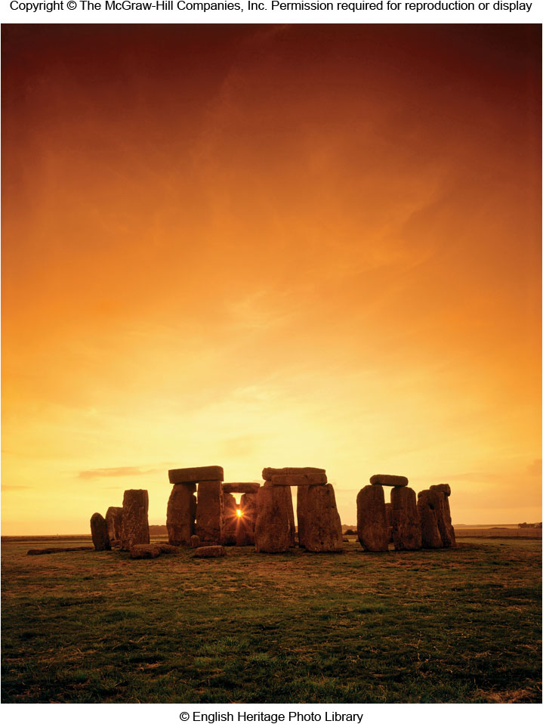
Chapter 1
Cycles of the Sky
Copyright © McGraw-Hill Education. Permission required for reproduction or display.

Slide 10
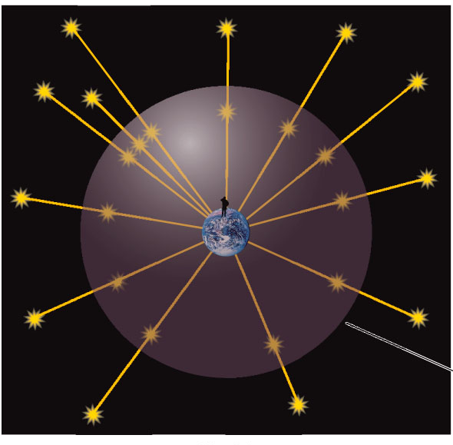
The Celestial Sphere
Vast distances to stars prevent us from sensing their true 3-D arrangement
Naked eye observations treat all stars at the same distance, on a giant celestial sphere with the Earth at its center

Slide 11
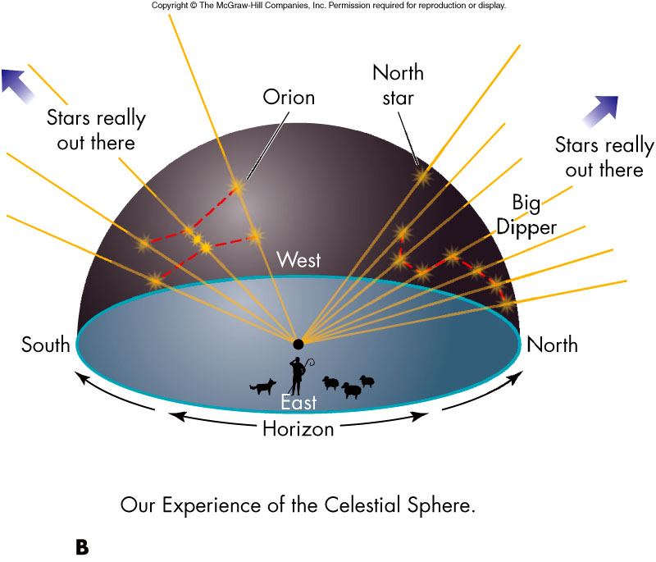
Models and Science
The celestial sphere is a model, which does not necessarily match physical reality
Models provide a means to enhance our understanding of nature

Slide 12
Constellations
Constellations are fixed arrangements of stars that resemble animals, objects, and mythological figures
Stars in a constellation are not physically related

Slide 13
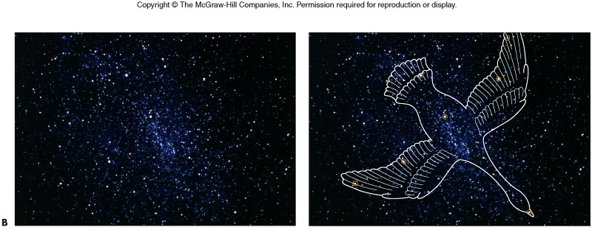
Appearance of Constellations over Time
Positions of stars change very slowly; constellations will look the same for thousands of years
Origin of the ancient constellations is unknown although they probably served as mnemonic tools for tracking seasons and navigation

Slide 14
Daily vs. Annual Motion
Daily Motion
Sun, Moon, planets, and stars rise in the east and set in the west
Due to the Earth’s rotation
Ancient astronomers took all celestial motion to be diurnal (daily)
The Celestial Sphere!
Annual Motion
“Yearly Motion”
Due to the Earth’s revolution
Is the sky different from day to day?
Month to month?
Year to year?

Slide 15
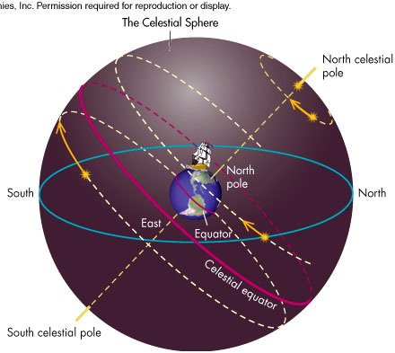
Daily Motion
Daily motion can be explained by the rotation of the celestial sphere about the north and south celestial poles located directly above the Earth’s north and south poles
The celestial equator, which lies directly above the Earth’s equator, provides another astronomical reference marker

Slide 16
Motion of Constellations
For a given time (say 10:00 PM), as the months proceed, constellations do not appear in the same part of the sky

Slide 17
Annual Motion
A given star rises 3 minutes 56 seconds earlier each night
This annual motion is caused by the Earth’s motion around the Sun, the result of projection
The ancients used the periodic annual motion to mark the seasons

Slide 18
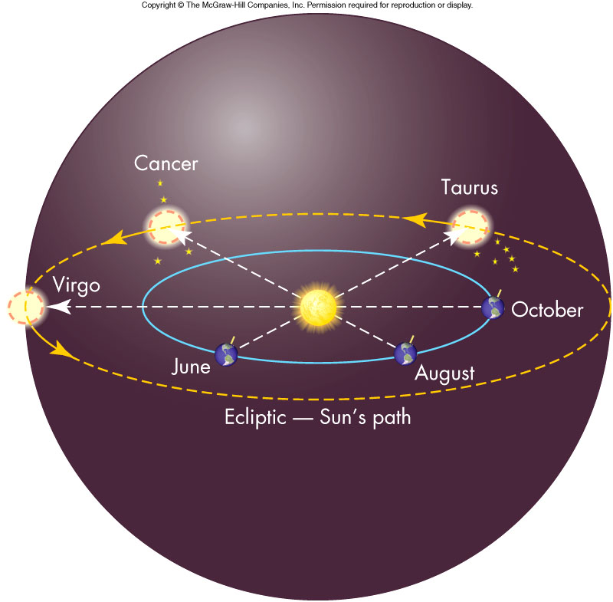
The Ecliptic
The path of the Sun through the stars on the celestial sphere is called the ecliptic
The ecliptic is a projection of the Earth’s orbit onto the celestial sphere and is tipped relative to the celestial equator

Slide 19
The Zodiac
The belt-shaped region of the sky surrounding the ecliptic passes primarily through twelve constellations and is called the zodiac.
A thirteenth constellation has joined the zodiac, Ophiuchus, the snake charmer.

Slide 20
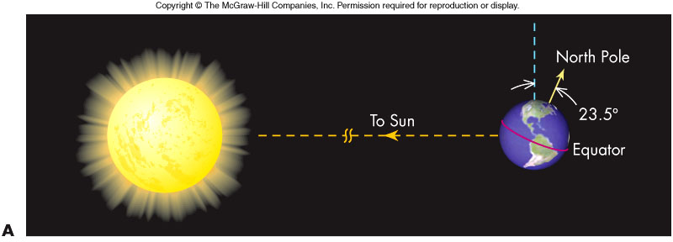
What Causes Seasons?
The Earth is closest to the Sun in January, which is winter in the northern hemisphere
Therefore, the seasons cannot be caused by the Sun’s proximity to the Earth
The Earth’s rotation axis is tilted 23.5º from a line perpendicular to the Earth’s orbital plane

Slide 21
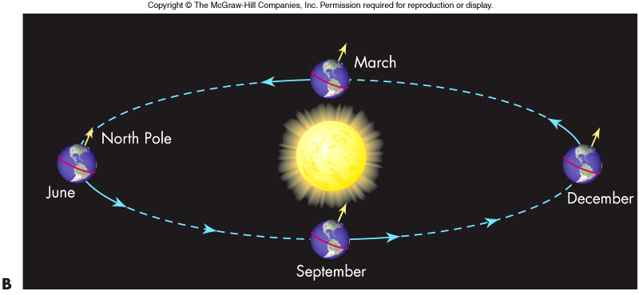
Axial Tilt Causes Seasons
The rotation axis of the Earth maintains nearly the same tilt (23.5 degrees) and direction from year to year.
The northern and southern hemispheres alternate receiving (on a yearly cycle) the majority of direct light from the Sun, and longer days.
This leads to the seasons!

Slide 22
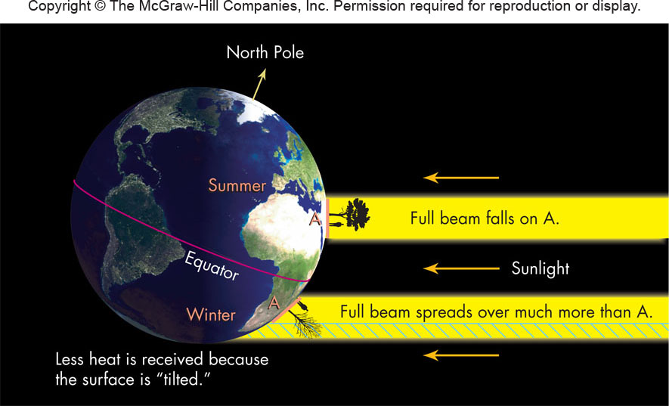
The Seasons

Slide 23
Seasons and The Ecliptic
The tilt of the Earth’s rotation axis causes the ecliptic not to be aligned with the celestial equator
Sun is above celestial equator in June when the Northern Hemisphere is tipped toward the Sun, and is below the equator in December when tipped away
Tilting explains seasonal altitude of Sun at noon, highest in summer and lowest in winter

Slide 24
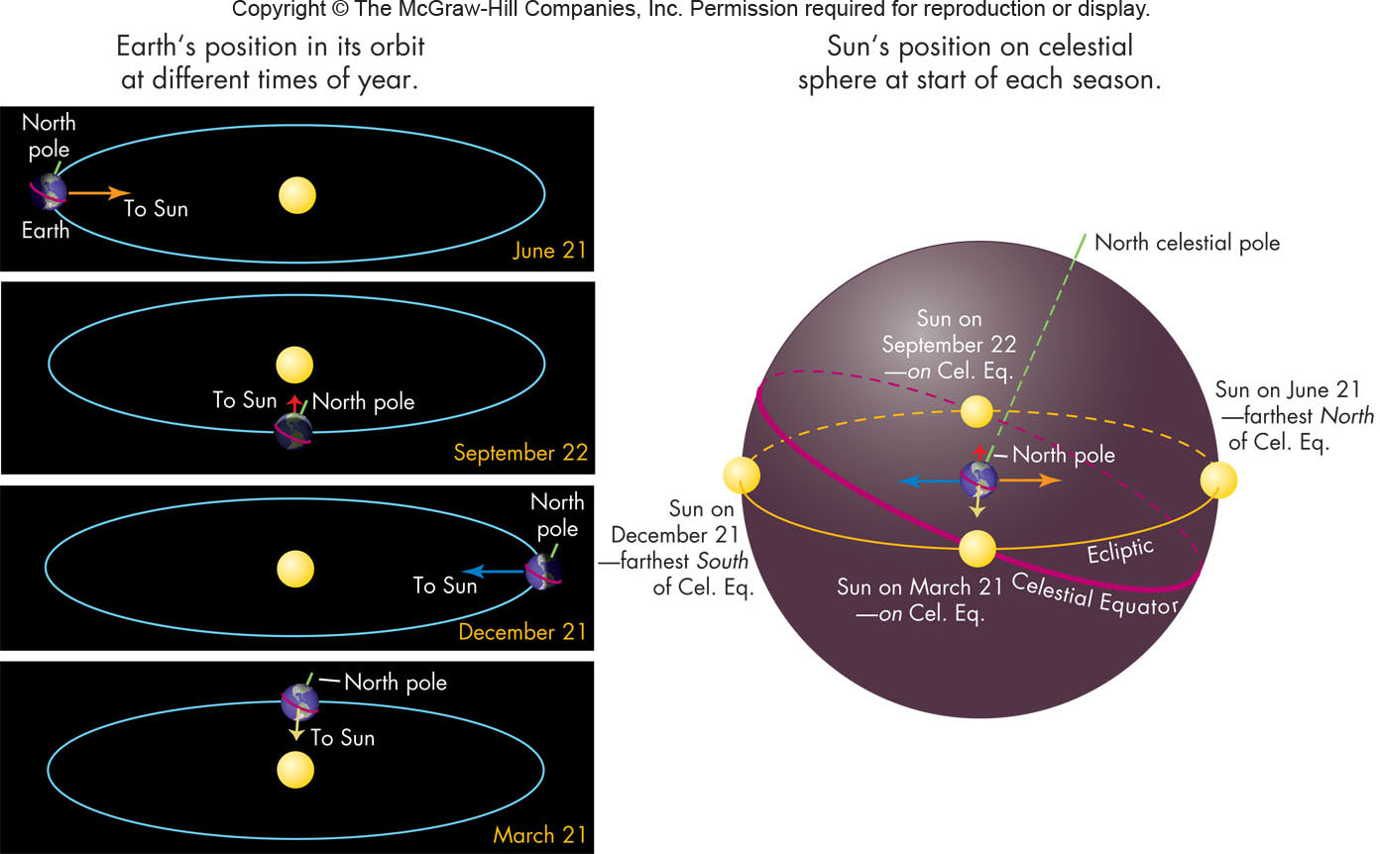
The Ecliptic’s Tilt

Slide 25
Solstices and Equinoxes
Points on horizon where Sun rises and sets changes periodically throughout year
In summer months of Northern hemisphere, the Sun rises north of east and sets north of west
In winter months of Northern hemisphere, the Sun rises south of east and sets south of west
The solstices (about June 21 and December 21) are when the Sun rises at the most extreme north and south points
The equinoxes (equal day and night and about March 21 and September 23) are when the Sun rises directly east
Ancients marked position of Sun rising and setting to determine the seasons (e.g., Stonehenge)

Slide 26
Sunset Directions Through the Seasons

Slide 27
The Sun’s Changing Position
Because the Sun moves north and south of the celestial equator during the year, the Sun does not rise due east or set due west on most days.
The shift of the Sun’s position is particularly obvious near the equinoxes, when the Sun’s position on the horizon shifts by almost its own diameter each day

Slide 28
The Path of the Sun Changes with Latitude
The motion of the Sun north and south in the sky over the course of the year causes the Sun to follow different paths through the sky each day as the Earth rotates.
The path the Sun follows each day can be quite different at different latitudes

Slide 29
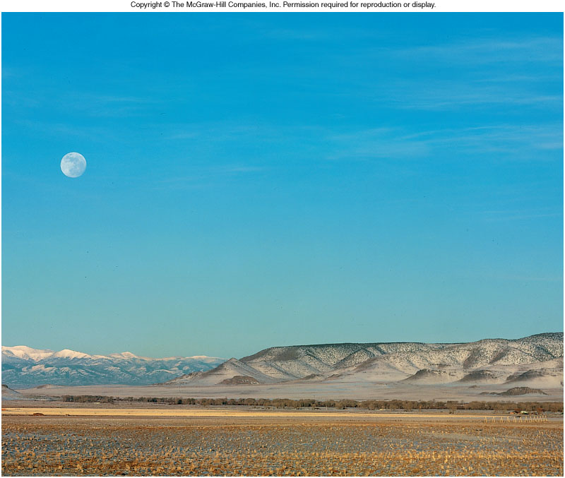
The Moon
Rises in the east and sets in the west
Like the planets and Sun, the Moon moves from west to east relative to the stars (roughly the width of the Moon in one hour)

Slide 30
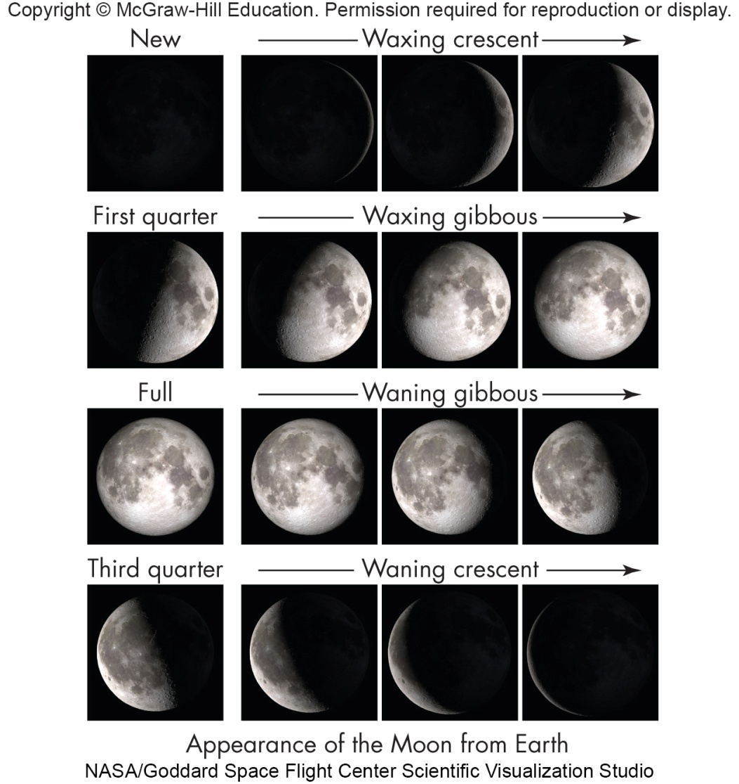
The Phases of the Moon
During a period of about 30 days, the Moon goes through a complete set of phases: new, waxing crescent, first quarter, waxing gibbous, full, waning gibbous, third quarter, waning crescent

Slide 31
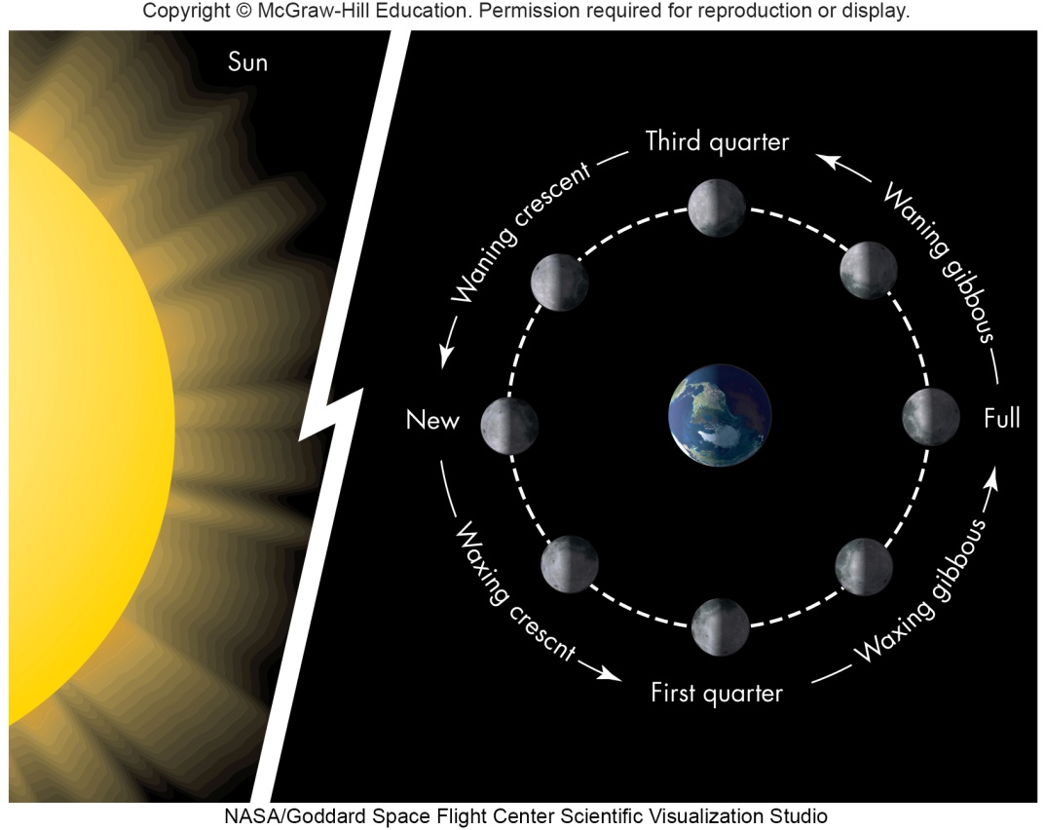
The Phase Cycle
The phase cycle is the origin of the month (derived from the word moon) as a time period
The phases of the Moon are caused by the relative positions of the Sun, Earth, and Moon

Slide 32
Lunar Rise and Set Times
The Moon rises roughly 50 minutes later each day
The changing time of moonrise means that the Moon is visible at different times and places during the night or day depending on its phase.

Slide 33
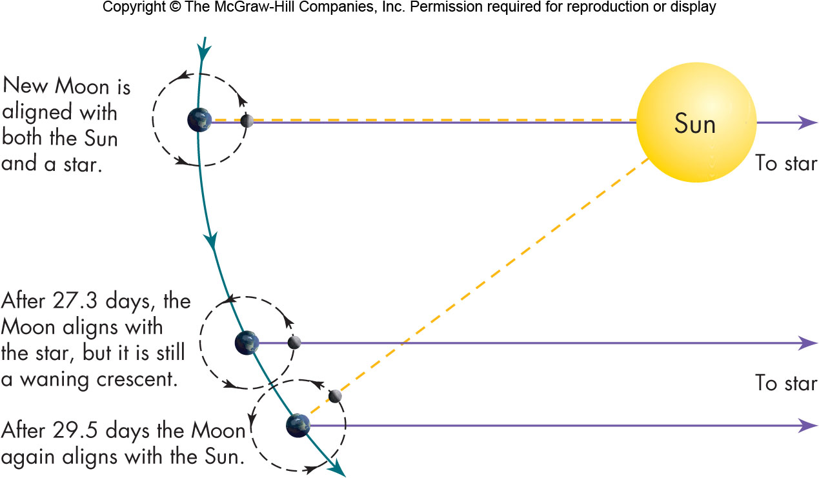
The Sidereal Month

Slide 34
Eclipses
An eclipse occurs when the Sun, Earth, and Moon are directly in line with each other
A solar eclipse occurs when the Moon passes between the Sun and Earth, with the Moon casting its shadow on the Earth causing a midday sky to become dark as night for a few minutes

Slide 35
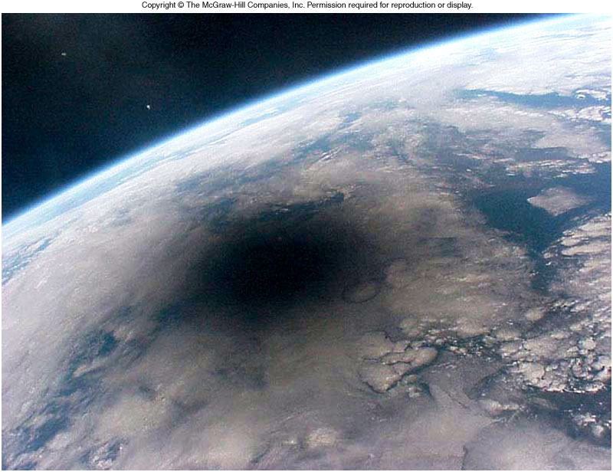
Solar Eclipse from Space

Slide 36
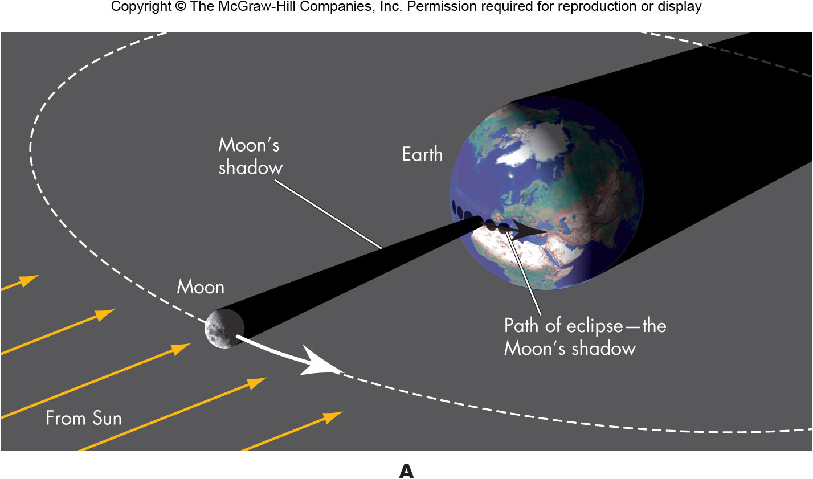
Solar Eclipses

Slide 37
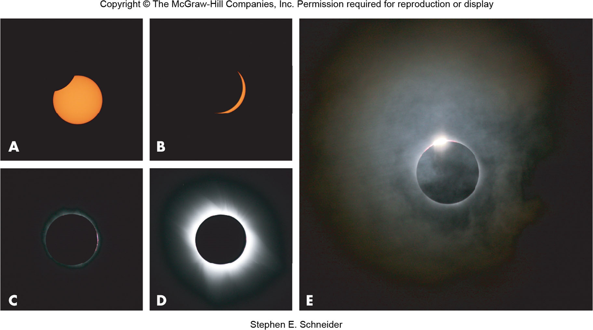
Stages of a Solar Eclipse

Slide 38
Lunar Eclipses
A lunar eclipse occurs when the Earth passes between the Sun and Moon, with the Earth casting its shadow on the Moon giving it a dull red color

Slide 39
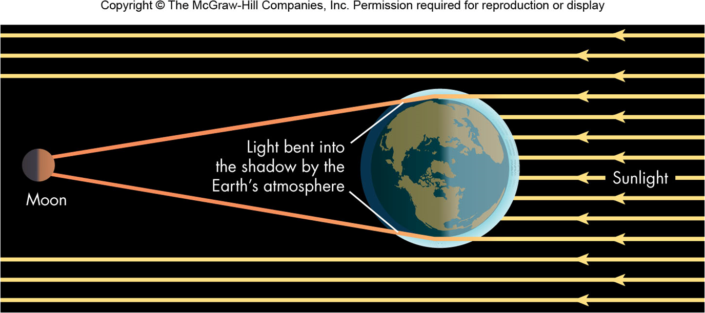
Red Moon
The Earth’s atmosphere bends some sunlight into the shadow.
The light reaching the Moon is red because interactions with particles in the air remove the blue light as it passes through our atmosphere.

Slide 40
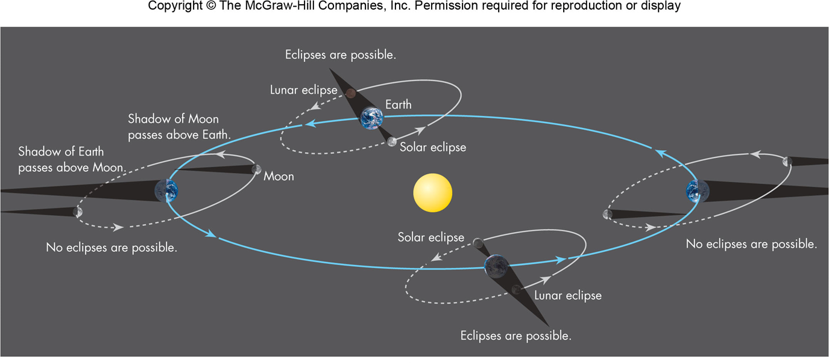
Rarity of Eclipses
Because of the Moon’s tilt relative to the ecliptic, eclipses will not occur at every new and full Moon
Twice a year the Moon’s orbit will pass through the Sun giving the possibility of an eclipse – these times are called eclipse seasons

Slide 41
Eclipse Seasons
Since the Moon’s orbit tilts nearly in the same direction through the year, twice a year the Moon’s orbit will pass through the Sun giving the possibility of an eclipse – these times are called eclipse seasons
When a solar eclipse occurs at new Moon, conditions are right for a lunar eclipse to occur at the full Moon either before or after the solar eclipse

Slide 42
Eclipse Periods
Eclipses do not occur every 30 days since the Moon’s orbit is tipped relative to the Earth’s orbit
The tipped orbit allows the shadow of the Earth (Moon) to miss the Moon (Earth)

Slide 43
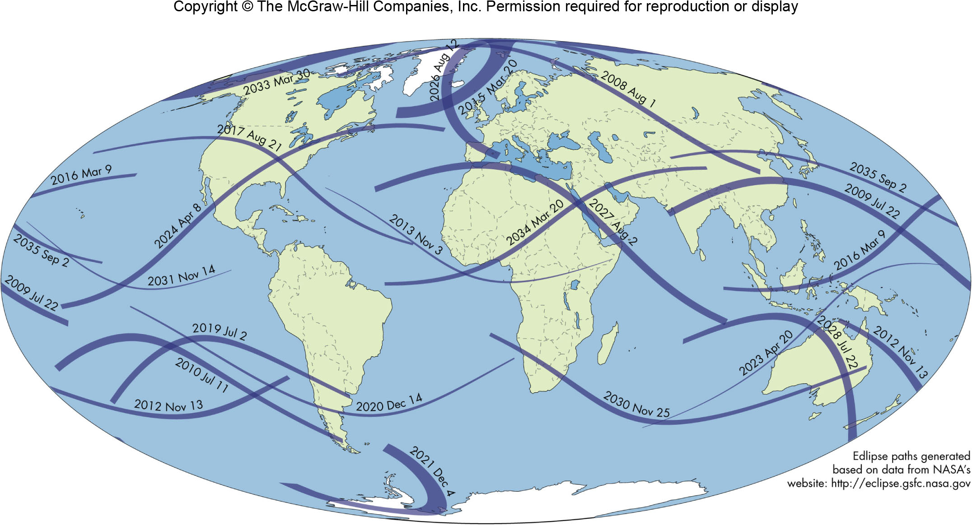
Recent and Upcoming Solar Eclipses

