Slide 1
Chapter 2: The Rise of Astronomy
30 Famous Astronomers

Slide 2
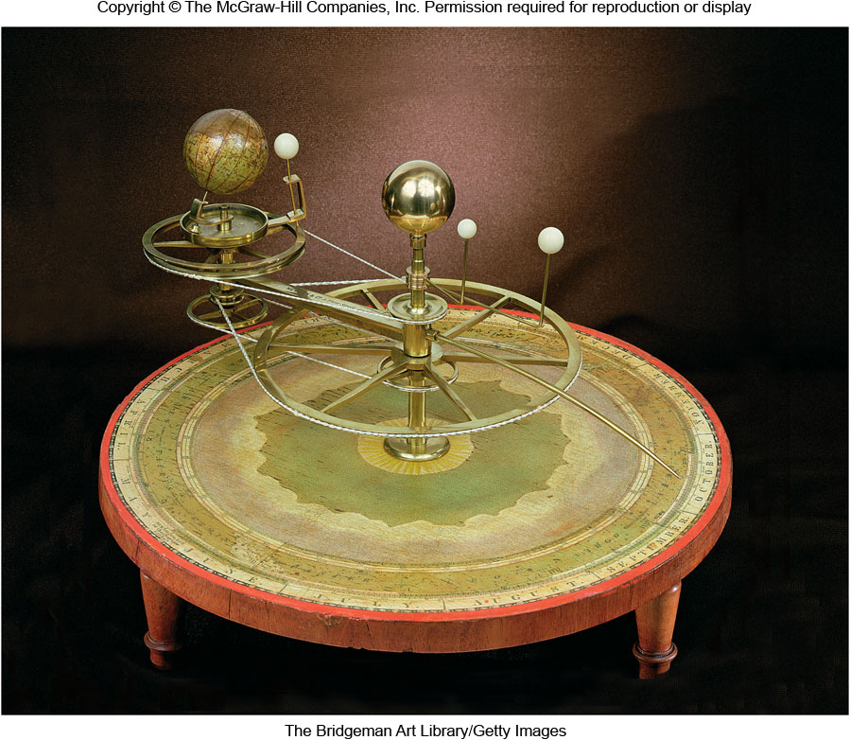
Chapter 2
The Rise of Astronomy
Copyright © McGraw-Hill Education. Permission required for reproduction or display.

Slide 3
Ancient Greek Astronomers
Through the use of models and observations, they were the first to use a careful and systematic manner to explain the workings of the heavens
Limited to naked-eye observations, their idea of using logic and mathematics as tools for investigating nature is still with us today
Their investigative methodology is in many ways as important as the discoveries themselves

Slide 4
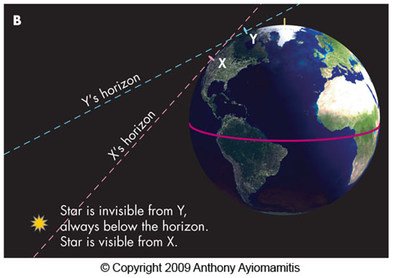
Early Ideas: Pythagoras
Pythagoras taught as early as 500 B.C. that the Earth was round, based on the belief that the sphere is the perfect shape used by the gods

Slide 5
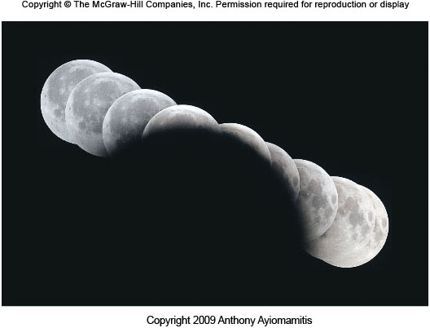
Early Ideas: Aristotle
By 300 B.C., Aristotle presented naked-eye observations for the Earth’s spherical shape:
Shape of Earth’s shadow on the Moon during an eclipse

Slide 6
More Observations of a Spherical Earth from Aristotle
He also noted that a traveler moving south will see stars previously hidden by the southern horizon
As ships sailed away from port, the hull would disappear first, and tops of sails last.

Slide 7
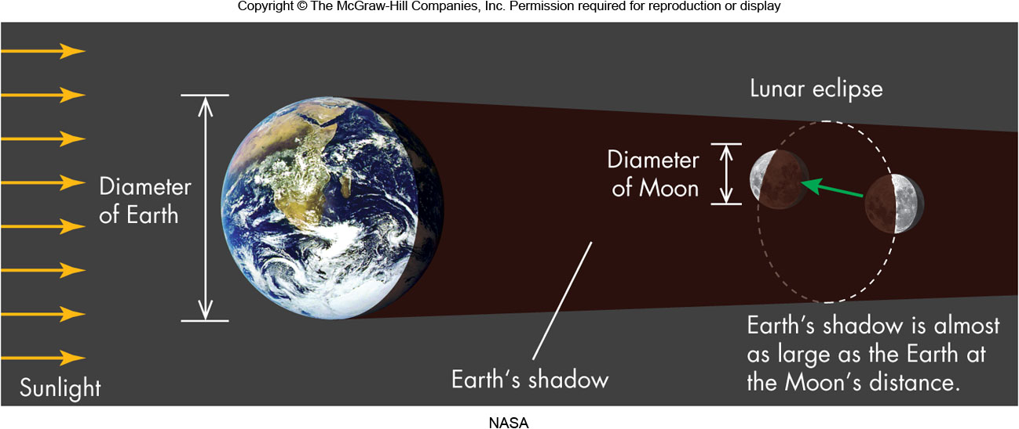
Early Ideas: Distance and Size of the Sun and Moon
The sizes and distances of the Sun and Moon relative to Earth were determined by Aristarchus about 75 years before Eratosthenes measured the Earth’s size
Once the actual size of the Earth was determined, the absolute sizes and distances of the Sun and Moon could be determined

Slide 8
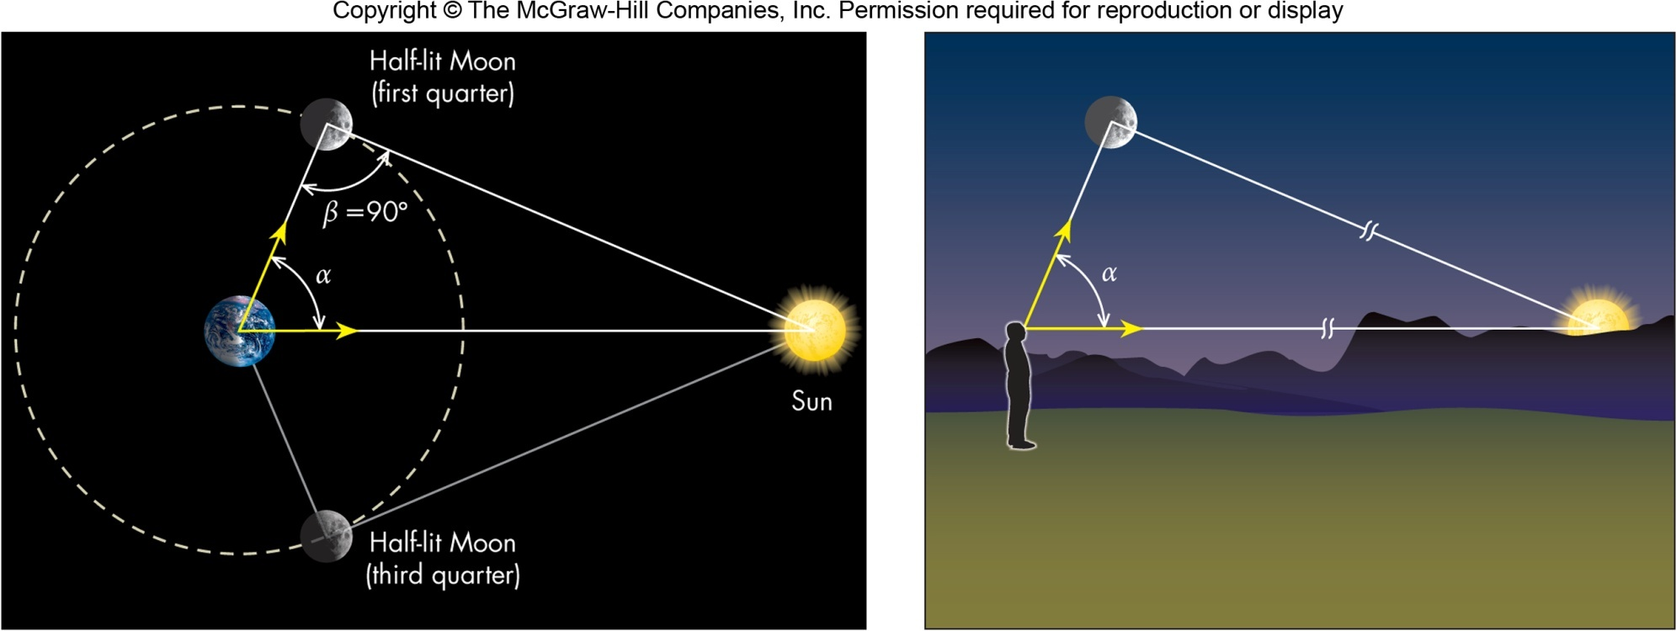
Relative Distance and Size of the Sun and Moon
These relative sizes were based on the angular size of objects and a simple geometry formula relating the object’s diameter, its angular size, and its distance

Slide 9
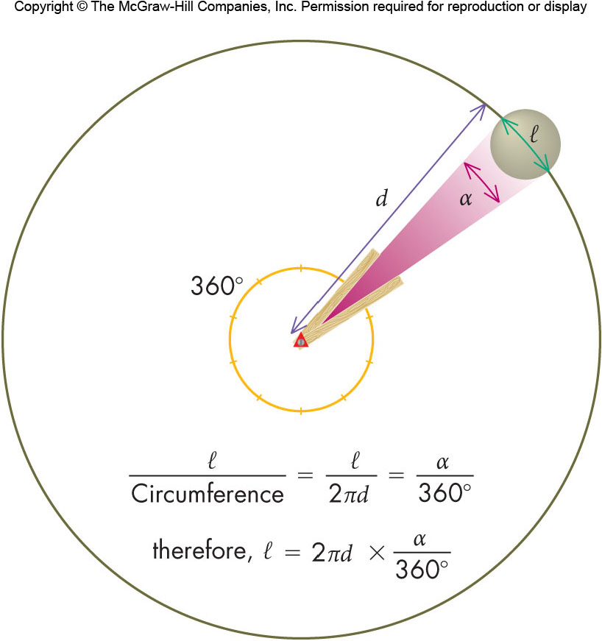
Measuring the Diameter of Astronomical Objects
$$l=2πd×\frac{α}{360°}$$
l – linear size of object
d – distance to object
α – angular size of object

Slide 10
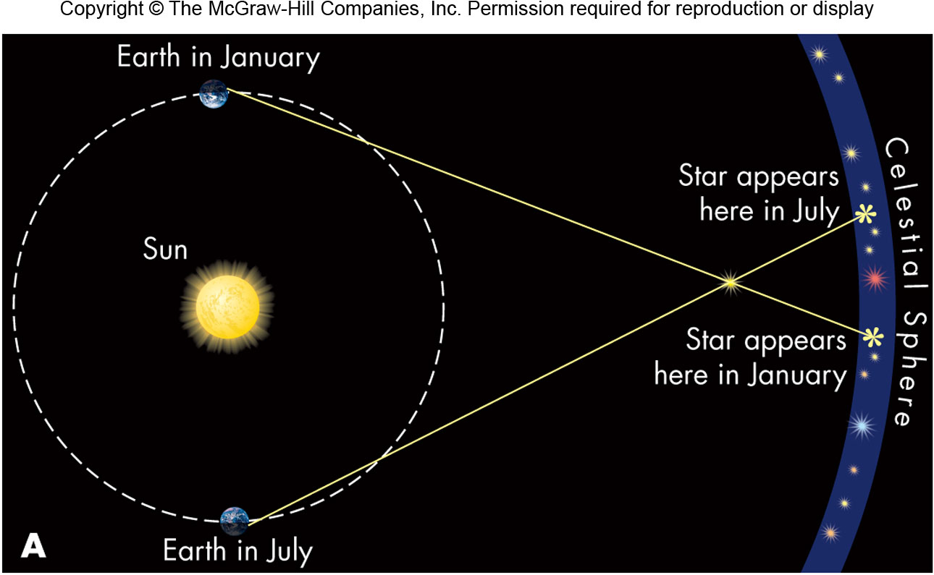
Early Ideas: Arguments for an Earth-centered Solar System
Aristarchus, realizing the Sun was very large, proposed the Sun as center of the Solar System, but the lack of parallax argued against such a model

Slide 11
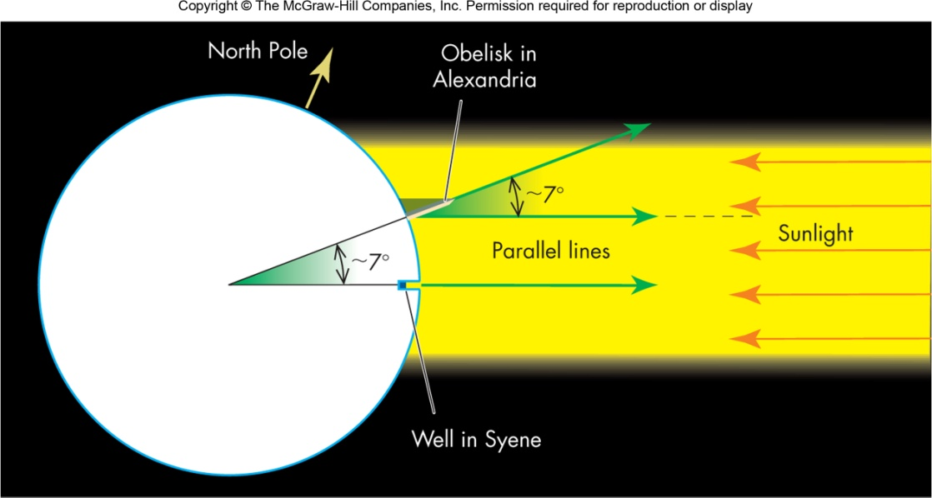
Early Ideas: Eratosthenes
Eratosthenes (276-195 B.C.) made the first measurement of the Earth’s size
He obtained a value of 25,000 miles for the circumference, a value very close to today’s value

Slide 12
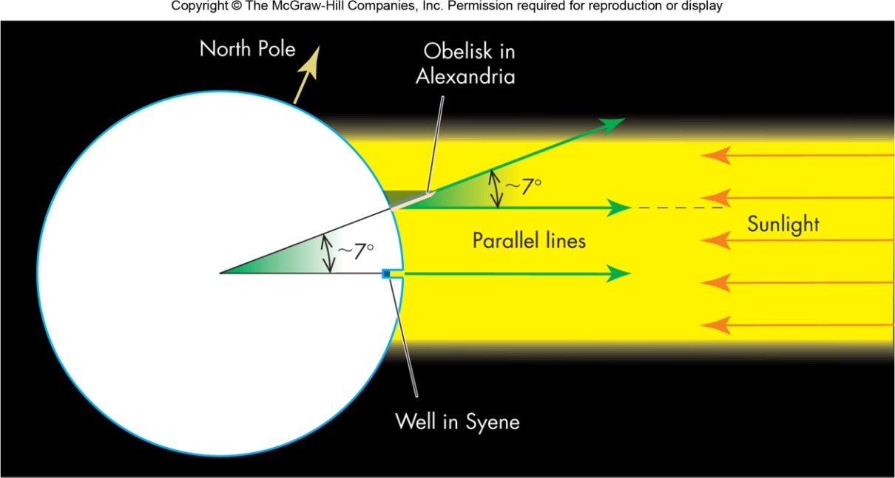
Early Ideas: The Size of the Earth
He measured the shadow length of a stick set vertically in the ground in the town of Alexandria on the summer solstice at noon, converting the shadow length to an angle of solar light incidence, and using the distance to Syene, a town where no shadow is cast at noon on the summer solstice

Slide 13
Planets and the Zodiac
The planets (Greek for “wanderers”) do not follow the same cyclic behavior of the stars
The planets move relative to the stars in a very narrow band centered about the ecliptic and called the zodiac
Motion and location of the planets in the sky is a combination of all the planets’ orbits being nearly in the same plane and their relative speeds about the Sun

Slide 14
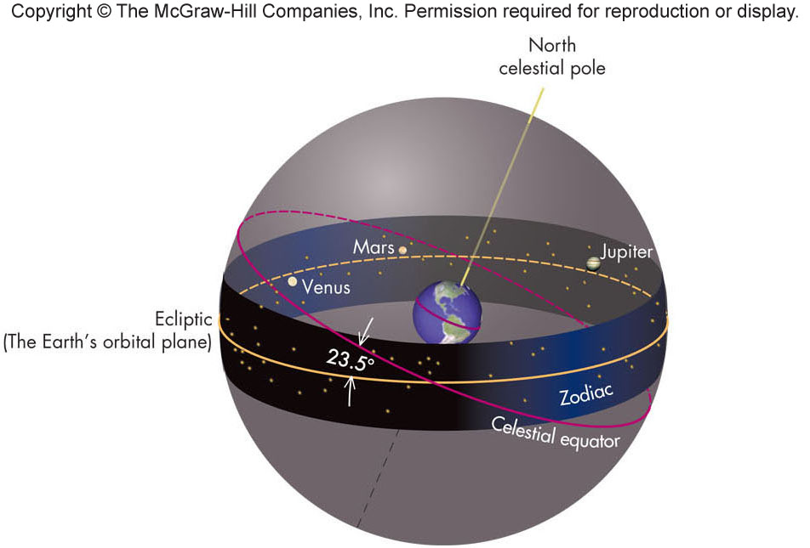
Motion of the Planets
Apparent motion of planets is usually from west to east relative to the stars, although on a daily basis, the planets always rise in the east

Slide 15
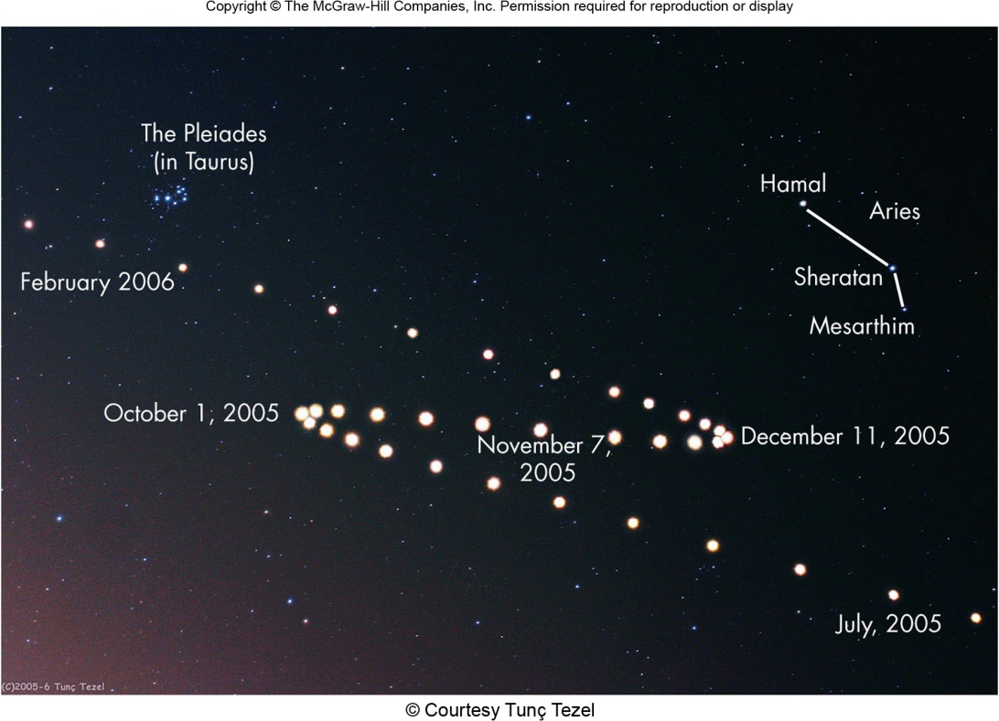
Retrograde Motion
Occasionally, a planet will move from east to west relative to the stars; this is called retrograde motion
Explaining retrograde motion was one of the main reasons astronomers ultimately rejected the idea of the Earth being located at the center of the solar system

Slide 16
Early Ideas: The Geocentric Model
Because of the general east to west motion of objects in the sky, geocentric models were developed to explain the motions
Eudoxus (400-347 B.C.) proposed a geocentric model in which each celestial object was mounted on its own revolving transparent sphere with its own separate tilt
The faster an object moved in the sky, the smaller was its corresponding sphere
This simple geocentric model could not explain retrograde motion without appealing to clumsy and unappealing contrivances

Slide 17
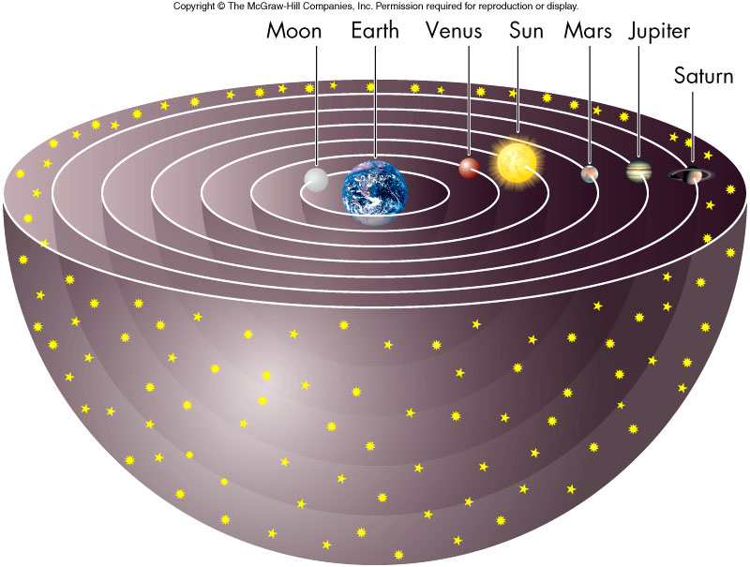
The Earth at the Center of the Universe!

Slide 18
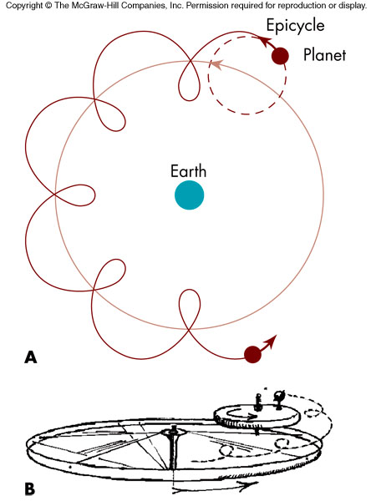
Ptolemy of Alexandria: Epicycles
Ptolemy of Alexandria improved the geocentric model by assuming each planet moved on a small circle, which in turn had its center move on a much larger circle centered on the Earth
The small circles were called epicycles and were incorporated so as to explain retrograde motion

Slide 19
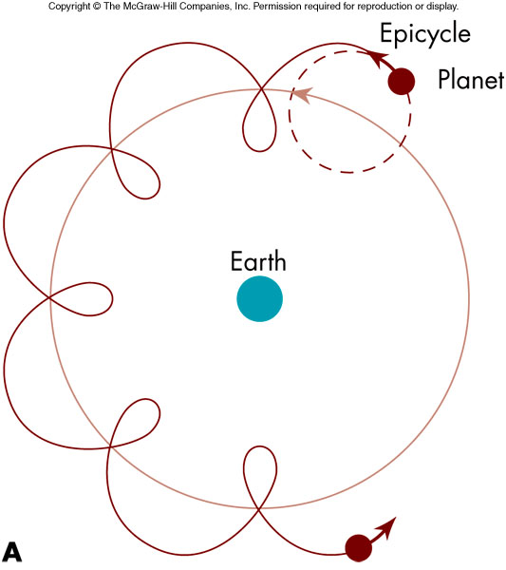
Ptolemy’s Success
Ptolemy’s model was able to predict planetary motion with fair precision
Discrepancies remained and this led to the development of very complex Ptolemaic models up until about the 1500s
Ultimately, all the geocentric models collapsed under the weight of “Occam’s razor” and the heliocentric models prevailed

Slide 20
Non-Western Contributions
Islamic Contributions
Studied and expanded upon ancient texts while the rest of Europe struggled though the Middle Ages
Relied on celestial phenomena to set its religious calendar
Created a large vocabulary still evident today (e.g., zenith, Betelgeuse)
Developed algebra and Arabic numerals
Asian Contributions
Devised constellations based on Asian mythologies
Kept detailed records of unusual celestial events (e.g., eclipses, comets, supernova, and sunspots)
Eclipse predictions

Slide 21
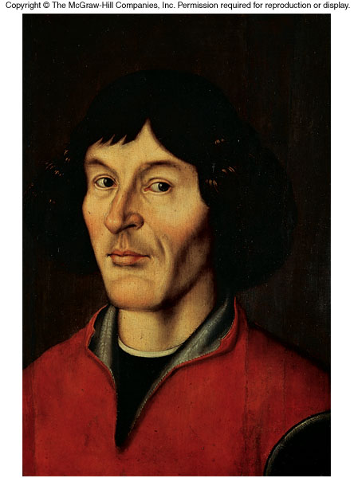
Astronomy in the Renaissance: Copernicus
Nicolaus Copernicus (1473-1543)
Could not reconcile centuries of data with Ptolemy’s geocentric model
Consequently, Copernicus reconsidered Aristarchus’s heliocentric model with the Sun at the center of the solar system

Slide 22
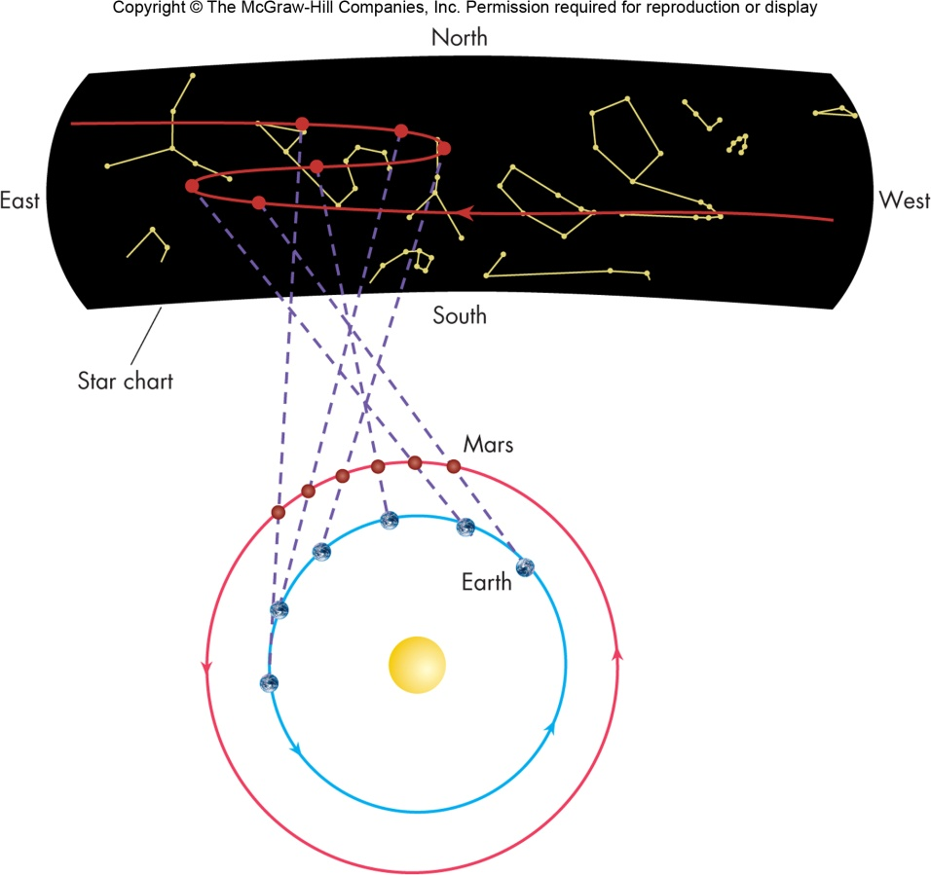
Copernicus’s Success
Heliocentric models explain retrograde motion as a natural consequence of two planets (one being the Earth) passing each other
Copernicus could also derive the relative distances of the planets from the Sun, and explain why Venus and Mercury were always close to the Sun.

Slide 23
Copernicus’s Failure
However, problems remained:
Could not predict planet positions any more accurately than the model of Ptolemy
Could not explain lack of parallax motion of stars
Conflicted with Aristotelian “common sense”

Slide 24
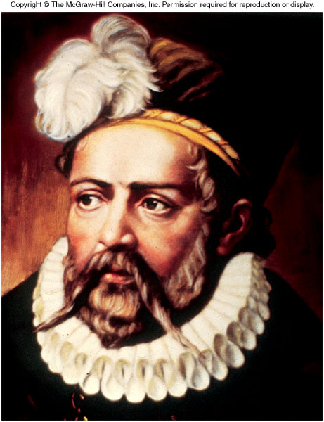
Astronomy in the Renaissance: Tycho Brahe
Tycho Brahe (1546-1601)
Designed and built instruments of far greater accuracy than any yet devised
Made meticulous measurements of the planets

Slide 25
Tycho Brahe’s Observations
Made observations (supernova and comet) that suggested that the heavens were both changeable and more complex than believed
Proposed compromise geocentric model, as he observed no parallax!

Slide 26
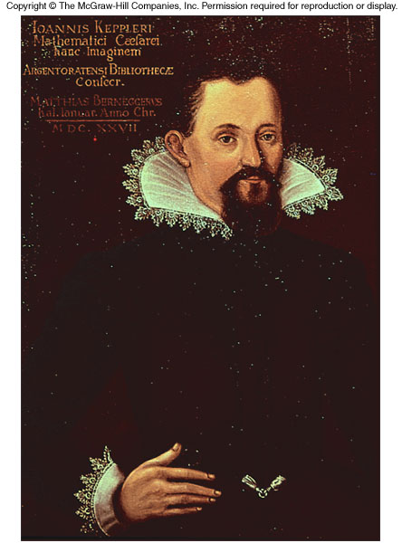
Astronomy in the Renaissance: Johannes Kepler
Johannes Kepler (1571-1630)
Upon Tycho’s death, his data passed to Kepler, his young assistant
Using the very precise Mars data, Kepler showed the orbit to be an ellipse

Slide 27
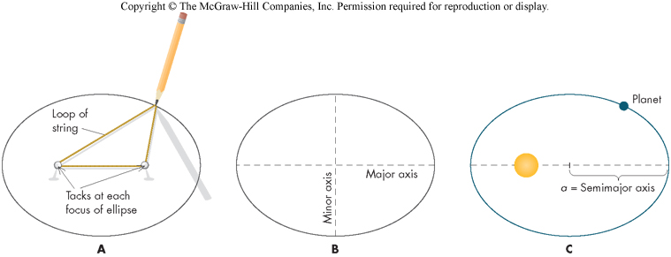
Kepler’s Success
Using Tycho Brahe’s data, discovered that planets do not move in circles around the Sun, rather, they follow ellipses with the Sun located at one of the two foci!
Astronomers use the term eccentricity to describe how round or “stretched out” an ellipse is – the higher (closer to 1) the eccentricity, the flatter the ellipse.

Slide 28
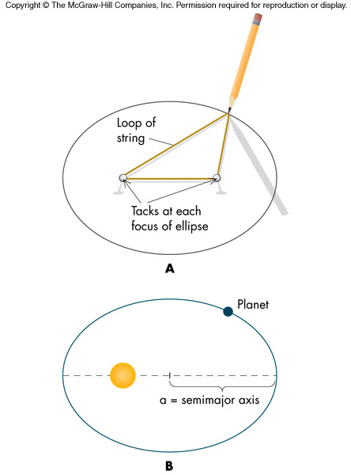
Kepler’s 1st Law
Planets move in elliptical orbits with the Sun at one focus of the ellipse

Slide 29
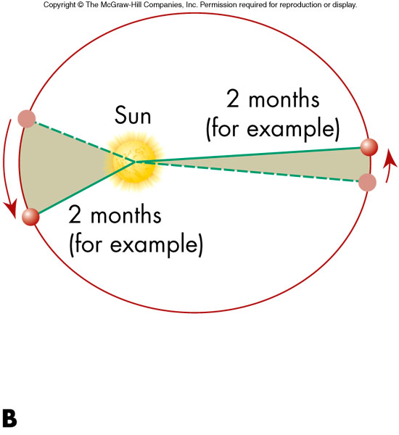
Kepler’s 2nd Law
The orbital speed of a planet varies so that a line joining the Sun and the planet will sweep out equal areas in equal time intervals
The closer a planet is to the Sun, the faster it moves

Slide 30
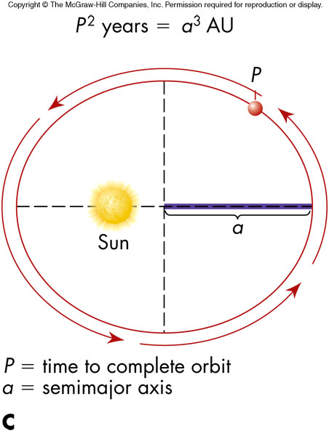
Kepler’s 3rd Law
The amount of time a planet takes to orbit the Sun is related to its orbit’s size
The square of the period, P, is proportional to the cube of the semimajor axis, a

Slide 31
Orbital Period and Distance
This law implies that a planet with a larger average distance from the Sun, which is the semimajor axis distance, will take longer to circle the Sun
Third law hints at the nature of the force holding the planets in orbit

Slide 32
Still in Use Today!
Third law can be used to determine the semimajor axis, a, if the period, P, is known, a measurement that is not difficult to make

Slide 33
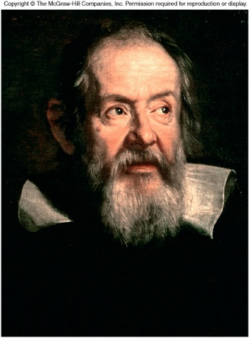
Astronomy in the Renaissance: Galileo
Galileo (1564-1642)
Contemporary of Kepler
First person to use the telescope to study the heavens and offer interpretations
The Moon’s surface has features similar to that of the Earth ⇒ The Moon is a ball of rock

Slide 34
Galileo’s Observations
The Sun has spots ⇒ The Sun is not perfect, changes its appearance, and rotates
Jupiter has four objects orbiting it ⇒ The objects are moons and they are not circling Earth
Milky Way is populated by uncountable number of stars ⇒ Earth-centered universe is too simple

Slide 35
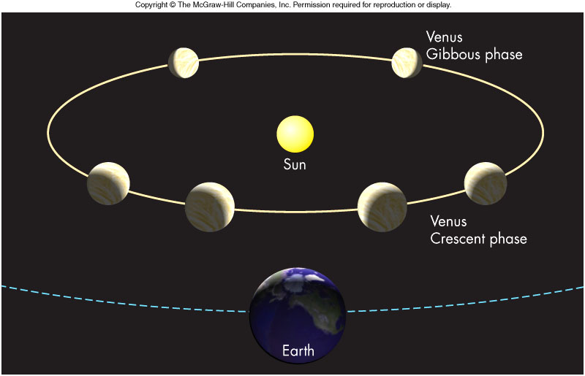
Evidence for the Heliocentric Model
Venus undergoes full phase cycle ⇒ Venus must circle Sun

Slide 36
One of the Founders of Modern Science
Credited with originating the experimental method for studying scientific problems
Deduced the first correct “laws of motion”
Was brought before the Inquisition and put under house arrest for the remainder of his life

Slide 37
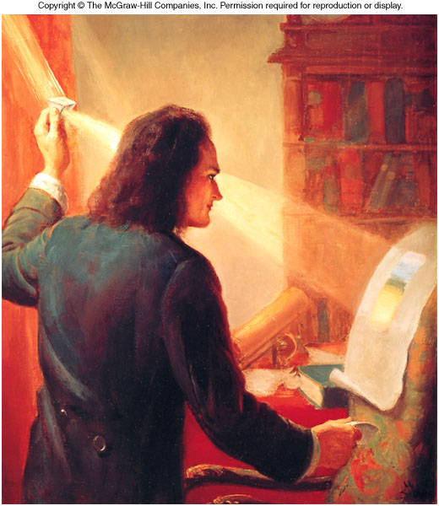
Isaac Newton
Isaac Newton (1642-1727) was born the year Galileo died
He made major advances in mathematics, physics, and astronomy

Slide 38
Newton’s Success
He pioneered the modern studies of motion, optics, and gravity and discovered the mathematical methods of calculus
It was not until the 20th century that Newton’s laws of motion and gravity were modified by the theories of relativity

Slide 39
The Growth of Astrophysics
New Discoveries
In 1781, Sir William Herschel discovered Uranus; he also discovered that stars can have companions
Irregularities in Uranus’s orbit together with law of gravity led to discovery of Neptune
New Technologies
Improved optics led to bigger telescopes and the discovery of nebulas and galaxies
Photography allowed the detection of very faint objects

